Slide 1
Decision by Committee: Ensemble Learning

Slide 2
Concept of Ensemble Learning

Slide 3
Ensemble Learning
Ensemble methods do very well when there is very little data as well as when there is too much.
When there was not enough data, we train lots of neural networks on different subsets of the data, and combine their results in some way.
One very simple way to combine the results is to use majority voting.
Majority voting has the interesting property that for binary classification, the combined classifier will only get the answer wrong if more than half of the classifiers were wrong, which hopefully will not happen too often.
There are alternative ways to combine the results.

Slide 4
Boosting

Slide 5
AdaBoost (adaptive boosting )

Slide 6

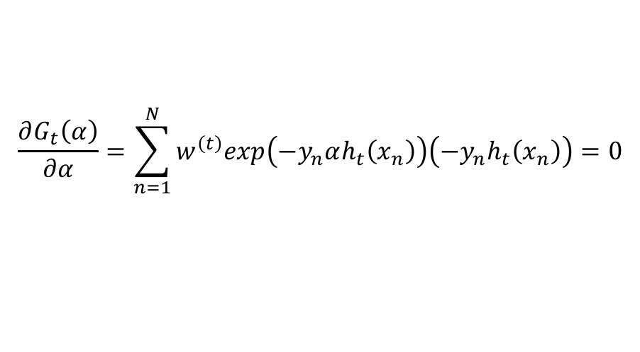
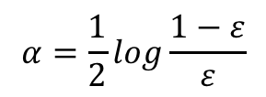
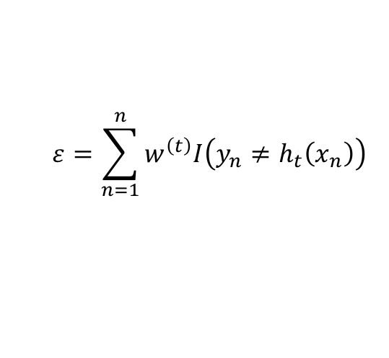
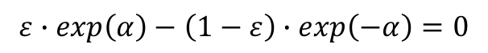
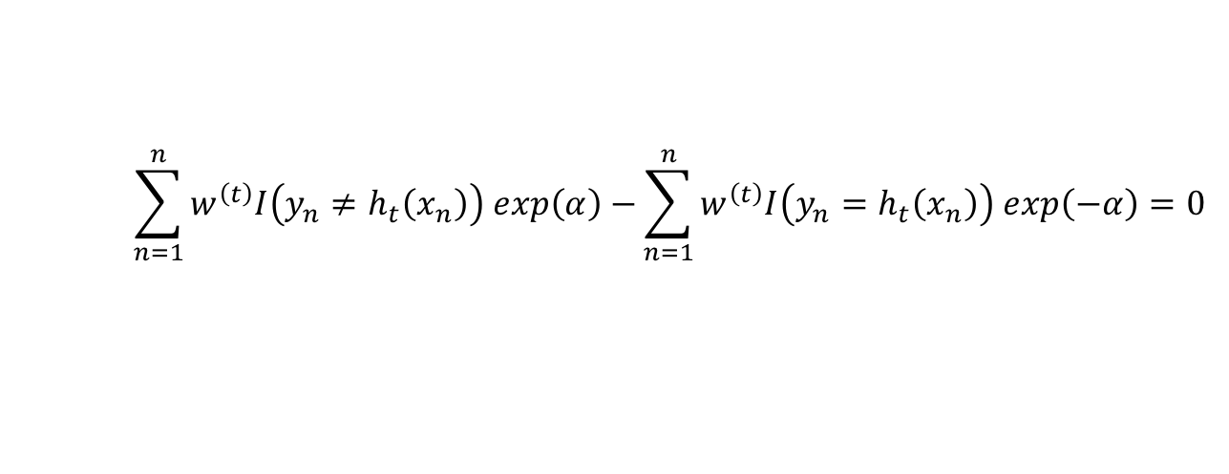
Statistical interpretation of AdaBoost (Friedman, et. al., 2000)
AdaBoost minimizes the exponential loss function
$$\frac{∂G_{t}\left(α\right)}{∂α}=\sum_{n=1}^{N}{w^{\left(t\right)}exp\left(−y_{n}αh_{t}\left(x_{n}\right)\right)\left(−y_{n}h_{t}\left(x_{n}\right)\right)=0}$$
$$\sum_{n=1}^{n}{w^{\left(t\right)}I\left(y_{n}≠h_{t}\left(x_{n}\right)\right) exp\left(α\right)−}\sum_{n=1}^{n}{w^{\left(t\right)}I\left(y_{n}=h_{t}\left(x_{n}\right)\right) exp\left(−α\right)}=0$$
$$ε=\sum_{n=1}^{n}{w^{\left(t\right)}I\left(y_{n}≠h_{t}\left(x_{n}\right)\right) }$$
$$ε∙exp\left(α\right)−\left(1−ε\right)∙exp\left(−α\right)=0$$
$$α=\frac{1}{2}log\frac{1−ε}{ε}$$
$\frac{∂G_{t}\left(α\right)}{∂w_{n}^{\left(t\right)}}=w^{\left(t\right)}exp\left(−y_{n}αh_{t}\left(x_{n}\right)\right)$= $w^{\left(t\right)}exp\left(α∙\left[2∙I\left(y_{n}≠h_{t}\left(x_{n}\right)\right)−1\right]\right)$

Slide 7
Bagging (Bootstrap aggregation)
A bootstrap sample is a sample taken from the original dataset with replacement,
We may get some data several times and other not at all.
The same size as the original
Each can be used to train a classifier, which performs slightly differently from each other.
Ensemble learning: taking the output to be the majorityvote of all the classifiers
May reduce variance of prediction
Bragging: combining boosting and bagging
Subbagging: the same size is different (often smaller) from the original

Slide 8
Random Forest
Different from bagging
Once the set of trees are trained, the output of the forest is the majority vote for
Classification; for regression, output the mean response.

Slide 9
Constructing a Decision Tree From Data
Decision making from top (root) to bottom (leaves)
A collection of logical disjunctions: if … then … else … rules
Determine the order of features (top to bottom): energy level, deadline, there is a party or not.
Often in a greedy manner: starting at the root, choosing the most informative feature.
Goal of constructing a tree from data: maximum number of matched predictions

Slide 10
Majority voting
Some classification systems will only produce an output where all the classifiers agree, or more than half of them agree, whereas others simply take the most common output.
Assuming that each individual classifier has a success rate of p , the probability of the ensemble getting the correct answer follows a binomial distribution
If p>0.5 and T→ ∞, the summer approach 1, meaning even if each classifier only gets about half the answers right, if we use a decent number of classifiers (~100), then the probability of the ensemble being correct gets close to 1.
T: the number of classifiers

Slide 11
Mixture of experts network: learning how to combine classifiers?
Logistic regression
Softmax
Learning: the parameters (weighs) using gradient descent algorithm, and structure (which data fed to which expert) using an EM algorithm or

